Slide 1
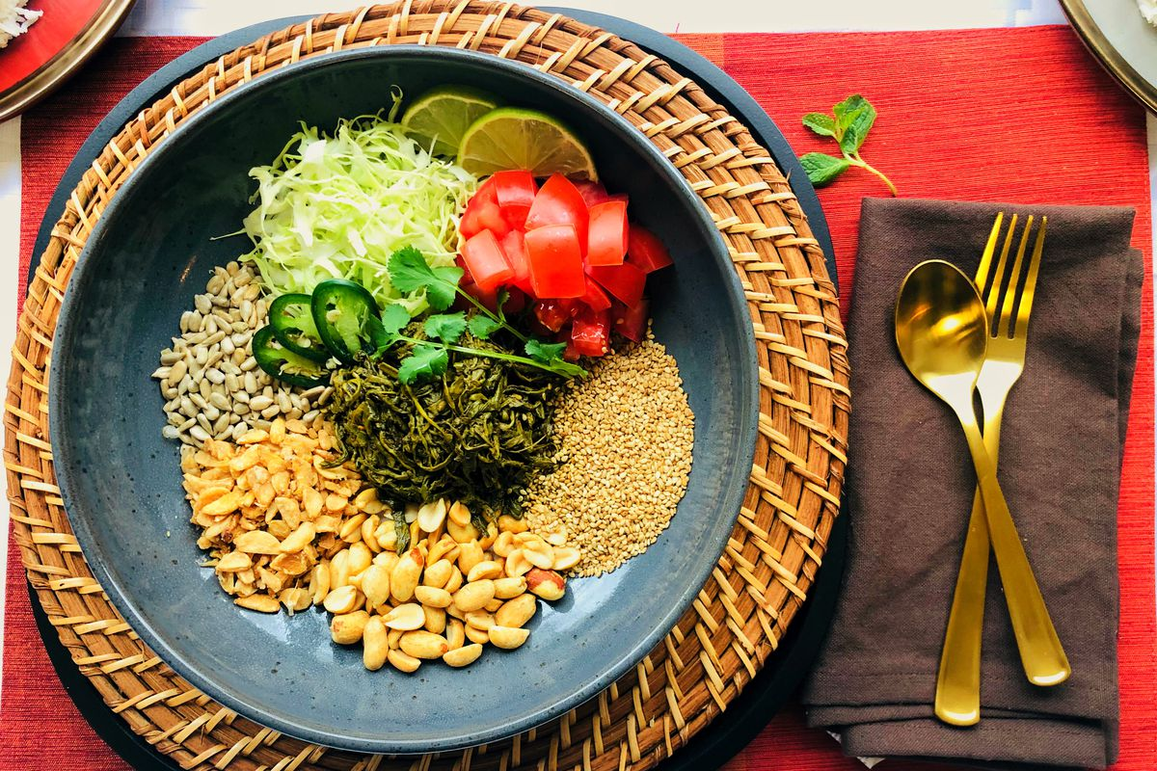
Model to Predict the Best Suitable Location for opening a new Restaurant
Capstone Project

Slide 2
Introduction
For this Capstone project, I am creating a hypothetical scenario for a concept Burmese restaurateur who wants to explore opening an authentic Burmese restaurant in Toronto area. The idea behind this project is that there may not be enough Burmese restaurants in Toronto and it might present a great opportunity for this entrepreneur who is based in Canada.
As Burmese food is very similar to other Asian cuisines, this entrepreneur is thinking of opening this restaurant in locations where Asian food is popular (aka many Asian restaurants in the neighborhood).
With the purpose in mind, finding the location to open such a restaurant is one of the most important decisions for this entrepreneur and I am designing this project to help him find the most suitable location.

Slide 3
Business Problem :
The objective of this capstone project is to find the most suitable location for the entrepreneur to open a new Burmese restaurant in Toronto, Canada.
By using data science methods and machine learning methods such as clustering, this project aims to provide solutions to ansIr the business question: In Toronto, if an entrepreneur wants to open a Burmese restaurant, where should they consider opening it?
Target Audience :
The entrepreneur who wants to find the location to open authentic Burmese restaurant

Slide 4
Data :
To solve this problem, I will need below data:
List of neighborhoods in Toronto, Canada.
Latitude and Longitude of these neighborhoods.
Venue data related to Asian restaurants. This will help us find the neighborhoods that are most suitable to open a Burmese restaurant.
Extracting the Data :
Scrapping of Toronto neighborhoods via Wikipedia
Getting Latitude and Longitude data of these neighborhoods via Geocoder package
Using Foursquare API to get venue data related to these neighborhoods

Slide 5
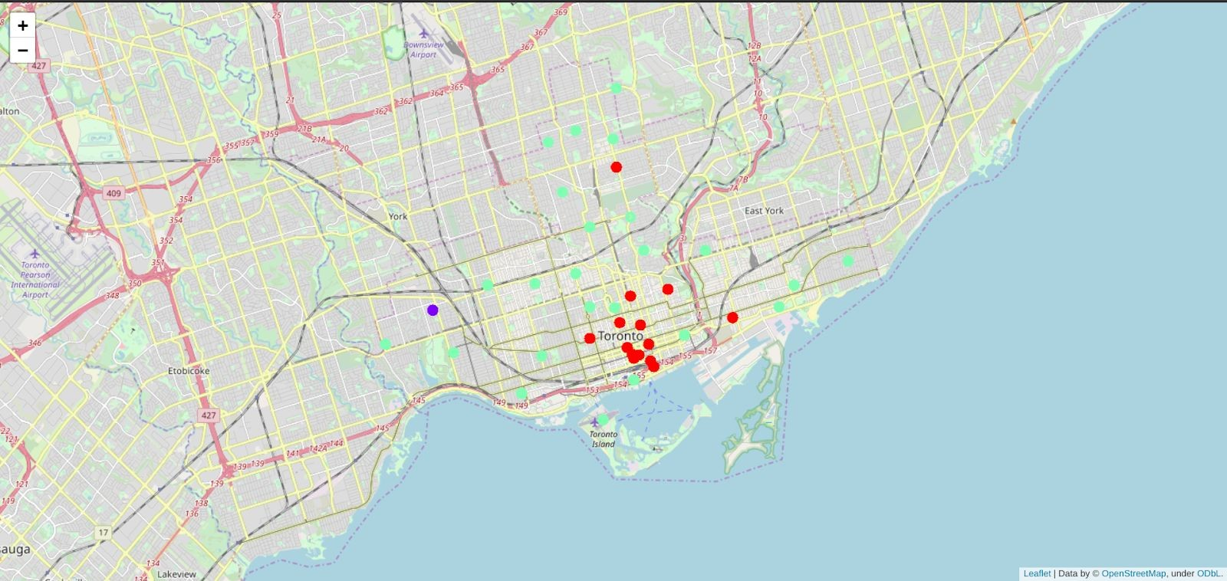
Results :
Clusters

Slide 6
The results from k-means clustering show that we can categorize Toronto neighborhoods into 3 clusters based on how many Thai restaurants are in each neighborhood:
Cluster 0: Neighborhoods with little or no Thai restaurants
Cluster 1: Neighborhoods with no Thai restaurants
Cluster 2: Neighborhoods with high number of Thai restaurants
The results are visualized in the above map with Cluster 0 in red color, Cluster 1 in purple color and Cluster 2 in light green color.
Recommendations :
Most of Thai restaurants are in Cluster 2 which is around Adelaide, King, Richmond areas and lowest (close to zero) in
Cluster 1 areas which are North Toronto West and Parkdale areas.
Also, there are good opportunities to open near Chinatown, St James town as the competition seems to be low. Looking at nearby venues, it seems Cluster 1 might be a good location as there are not a lot of Asian restaurants in these areas. Therefore, this project recommends the entrepreneur to open an authentic Burmese restaurant in these locations with little to no competition. Nonetheless, if the food is authentic, affordable and good taste, I am confident that it will have great following everywhere :)

Slide 7
Limitations and Suggestions for Future Research :
In this project, I only take into consideration of one factor: the occurrence / existence of Thai restaurants in each neighborhood. There are many factors that can be taken into consideration such as population density, income of residents, rent that could influence the decision to open a new restaurant.
However, to put all these data into this project is not possible to do within a short time frame for this capstone project. Future research can take into consideration of these factors. In addition, I am relying on the existence of Thai restaurants only for this project but future research can take into consideration of other variables such as existence of Asian restaurants, Asian population level in each neighborhood etc.
Conclusion :
In this project, we have gone through the process of identifying the business problem, specifying the data required, extracting and preparing the data, performing the machine learning by utilizing k-means clustering and providing recommendation to the stakeholder.

